Slide 1

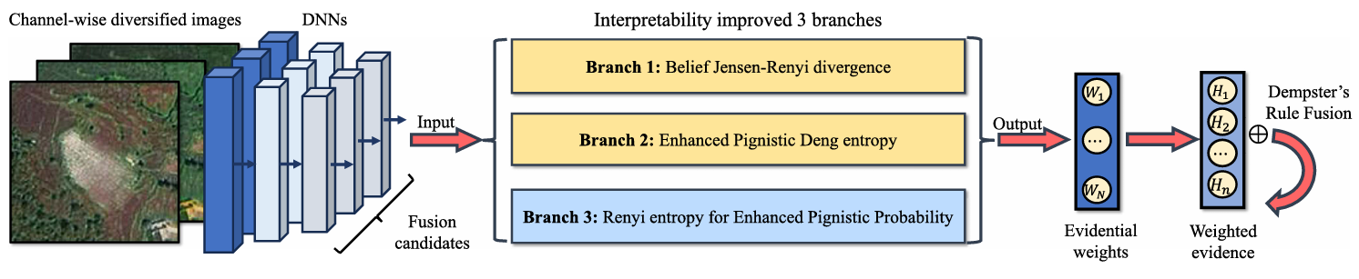
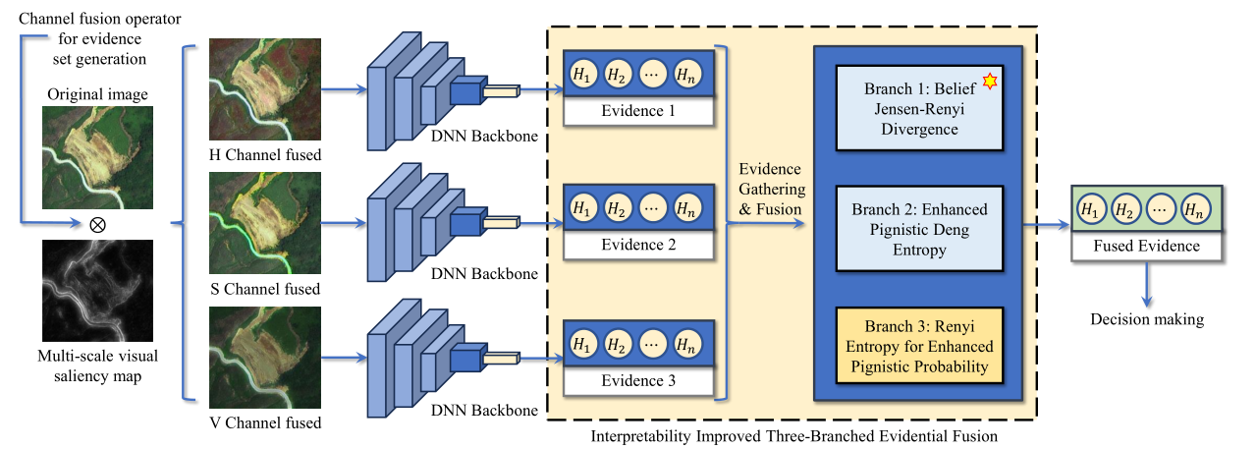
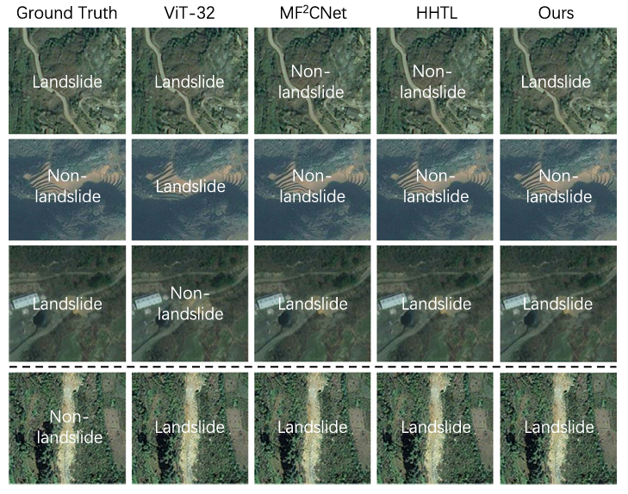
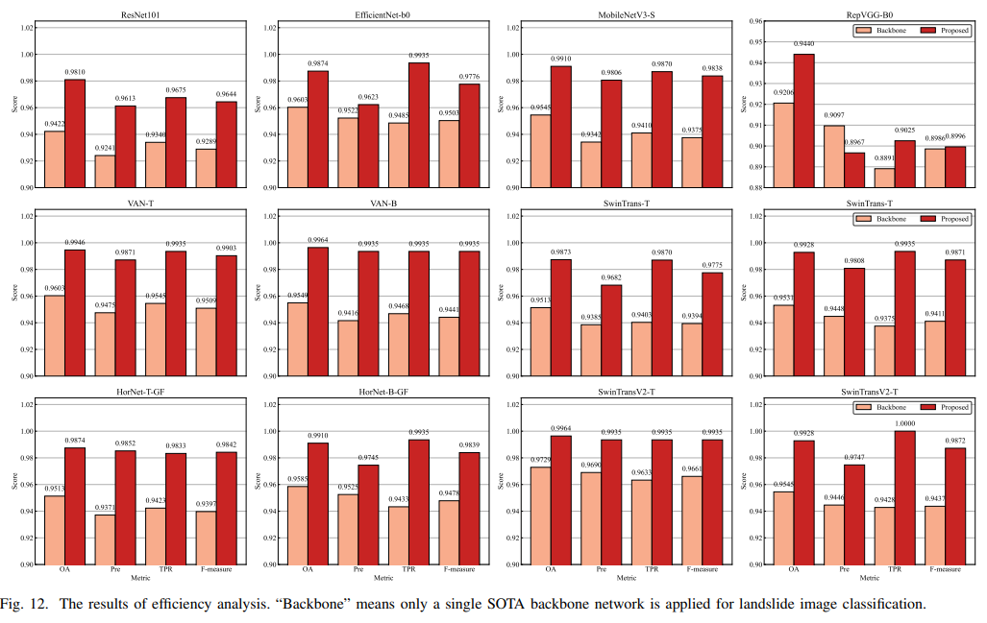
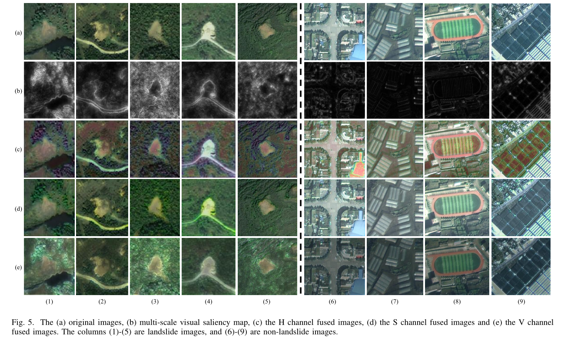
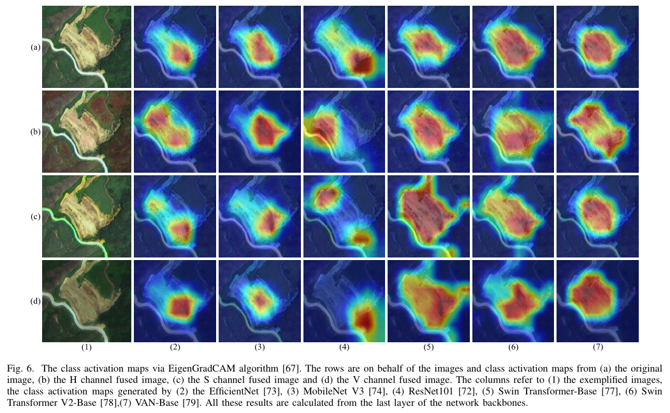
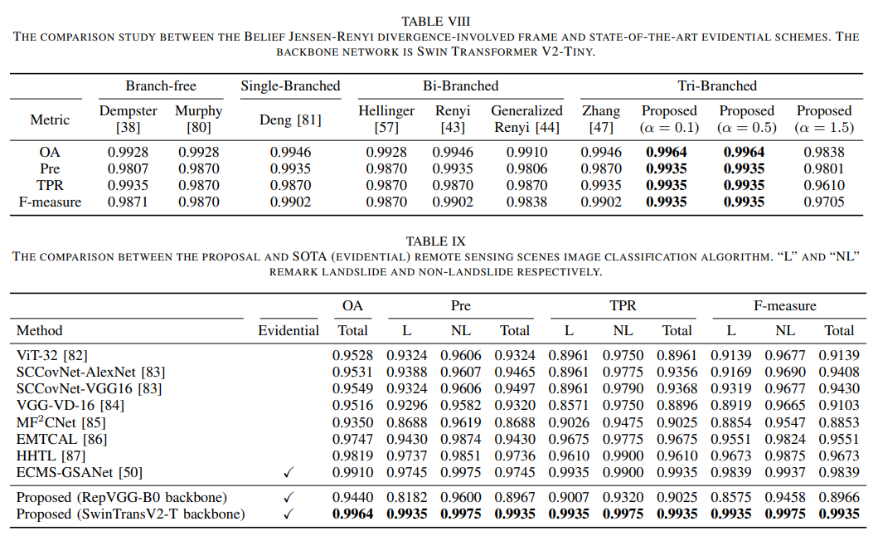
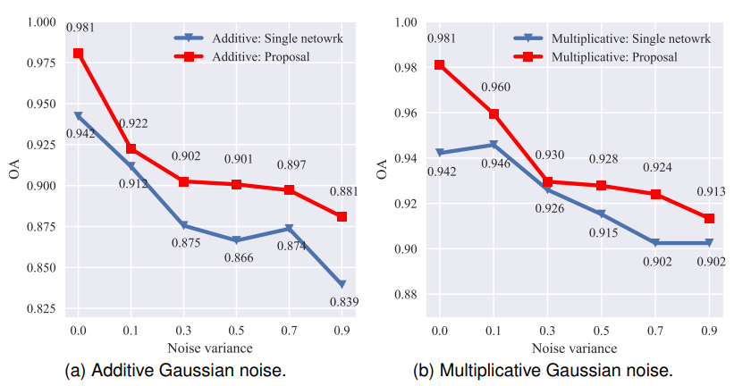
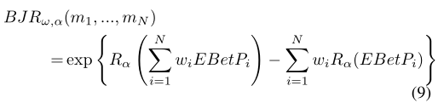
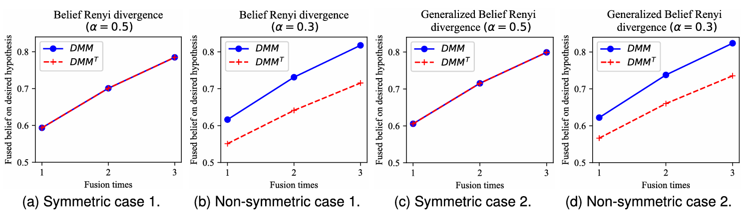
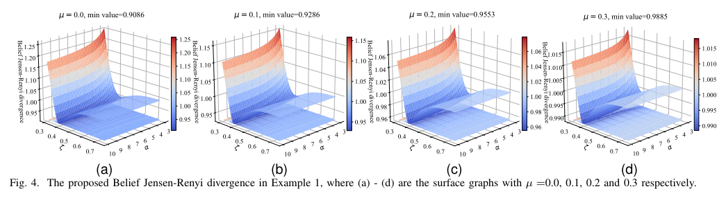
Deep Evidential Remote Sensing Landslide Image Classification With a New Divergence, Multiscale Saliency and an Improved Three-Branched Fusion
Jiaxu Zhang *, †, Qi Cui *, #, and Xiaojian Ma*
*CS, Northeast Forestry Univ., China †SECE, Sun Yat-sen Univ., China #CS, Northeastern Univ., China
Abstract: Hitherto, image-level classification on remote sensing landslide images has been paid attention to, but the accuracy of traditional deep learning-based methods still have room for improvement. The evidence theory is found efficient to boost the accuracy of neural networks, however, the present study argues three challenges that hinder the lead-in of this theory in deep landslide image classification. Aiming at the three problems, this study makes three improvements. For the interpretability and decision-invariance losses of three previous divergences, we propose a belief Jensen–Renyi divergence with properties proven. To couple the evidence theory with deep remote sensing landslide image classification, a channelwise multiscale visual saliency fusion is developed. We additionally find that the channelwise fusion is capable to reduce false recognition of networks as compared with original RGB images. To avoid decision failures in evidence-theoretic fusion process, we design an interpretability improved three-branched fusion. Experiments on Bijie Landslide dataset corroborate the synergistic benefits of the three improvements, where the proposal is compared with state-of-the-art image classification backbone networks, remote sensing image scene classifiers, evidence fusion algorithms, and versatile evidence-theoretic deep learning classifiers. We also evaluated the new method with two sort of image degradation, as well as an actual scenario in Luding County, China, whose data is publicly available.
DOI: 10.1109/JSTARS.2024.3354455 Github repo: https://github.com/defzhangaa/deeplandslideDS
1. Introduction
2. The Proposed Method
2.4 The interpretability improved three-branched evidence fusion
As displayed in Fig. 6, the newly improved fusion involves the new belief divergence and two belief entropies to solve the theoretical flaw of its former counterpart [2].
1.1 To improve DNN via evidence theory in remote sensing landslide image classification
Deep neural networks (DNNs) has shown advantages in remote sensing landslide image classification. Nevertheless, few of the recent image-level classification schemes are coupled with the well-known evidence theory to achieve a higher accuracy. The accuracy boosting effect of this theory in universal image-level classification [1] have been extensively discussed in recent documents. But in deep remote sensing landslide image classification, this theory has been relatively less studied, which is the major motivation of this study. Fig. 1 briefly presents the comparison in difficult sample recognition between traditional DNNs and the evidence theory-coupled model.
2.1 A horizontal view of the new proposal
The full proposal that simultaneously solves the mentioned “three challenges” for remote sensing landslide image classification has been exhibited in Fig. 3.
Evidence theory involvement challenge
Evidence conflict challenge
Belief divergence challenge
Fig. 6. The interpretability improved three-branched evidence fusion.
3. Results
We compared the proposal with (i) single image classification backbone networks, (ii) deep remote sensing scenes image classifiers and (iii) deep learning classifiers with evidence theory. Performances under different image color spaces and stimulated image noises are investigated as well. A real-world dataset test is executed in the end.
Fig. 3. The workflow of the new proposal.
2.2 Channelwise visual saliency fusion for evidence set generation
Firstly, the algorithm generates multi-scale SR saliency, and then the saliency map is fused into the H, S and V channels of the remote sensing landslide image, which induces the three deep neural networks to focus on different pixels of the landslide image, thus producing different decisions. This fusion is shown in Fig. 4.
Fig. 1. Illustrating instance of difficult samples and the classification results of both DNNs and evidence theory-coupled deep learning method (the current proposal).
1.2 The “three challenges” hindering the lead-in of evidence theory
Although the evidence theory has merits in decision fusion, the present study argues the next “three challenges” that hindering the lead-in of this theory:
Belief divergence challenge: Some belief divergences may limit evidence-theoretic landslide classification due to their explainability and decision invariance losses.
Evidence theory involvement challenge: For landslide image classification, how to efficiently form evidence set via deep learning to implement evidence theory is not off-the-shelf.
Evidence conflict challenge: The Dempster’s combination rule may bring about counter-intuitive classification results when “evidence conflict” occurs.
And the “decision-invariance loss” has been shortly illustrated in Fig. 2.
Fig. 4. The proposed channelwise fusion for evidence set generation.
2.3 The novel Belief Jensen-Renyi divergence
To tackle the explainability and decision invariance losses of two previous belief Renyi divergences, the present study proposes a Belief Jensen Renyi divergence (BJR). This belief divergence has the next mathematical form:
And one can learn that this divergence can handle multiple evidence, which is more generalized than the current remedy, and the ill-definition of its probability prototype is perfectly fixed. Instances of the new divergence are in Fig. 5.
References
Z. Han et al., Trusted Multi-View Classification With Dynamic Evidential Fusion, IEEE T. Pattern Anal., vol. 45, May 2022.
J. Zhang et al., Rail Surface Defect Detection Through Bimodal RSDINet and Three-Branched Evidential Fusion, IEEE T. Instrum. Meas., Mar. 2023, 2508714.
Acknowledgements: Sincerely thank Prof. Lianmeng Jiao in Northwestern Polytechnical University, China for his timely help on improving the paper’s quality.
Fig 2. The decision invariance loss of two previous belief Renyi divergences.
Fig. 5. Numerical example of the new Belief Jensen-Renyi divergence.
* Please contact zhangjx283@mail2.sysu.edu.cn for further information.
Published in IEEE Journal of Selected Topics in Applied Earth Observations and Remote Sensing, Vol. 17, 2024.

